Slide 1

Movie Genre Analysis and Insights for Microsoft
By Wilkins Nzioka​

Slide 2



Introduction
Microsoft's venture into the film industry.
Purpose
Motivation
This presentation aims to provide data-driven insights into the types of films that have performed well at the box office.
The growing success of original video content drives Microsoft's desire to enter the movie industry.

Slide 3
Agenda
Market Research Data
Top-Grossing Films
Genre Analysis
Yearly Trends
Global Market Analysis
Emerging Trends
Actionable Insights
Collaboration
Conclusion
Q&A

Slide 4
DaTA SOURCES
MARKET RESEARCH DATA
Box Office Mojo
industry reports
A widely recognized and comprehensive online database that tracks and provides detailed information on the financial performance of films in theaters.
Comprehensive documentation prepared by experts and organizations offering critical insights, statistics, and trends relevant to the film and entertainment sector.
IMDb
An online platform that provides a vast repository of information on films, television shows, actors, and industry professionals

Slide 5

Top-Grossing Films
# | Title | Domestic Gross | Year
1 | Star Wars: The Force Awakens | 936,700,000.0 | 2015
2 | Black Panther | 700,100,000.0 | 2018
3 | Avengers: Infinity War | 678,800,000.0 | 2018
4 | Jurassic World | 652,300,000.0 | 2015
5 | Marvel's The Avengers | 623,400,000.0 | 2012
Sci-fi movies have dominated the list of top-grossing films, due to their ability to captivate audiences with imaginative worlds, futuristic technologies, and compelling narratives.
Franchises offer established fan bases and increased box office potential; e.g., The 'Marvel Cinematic Universe' is a prime example of franchise success.

Slide 6
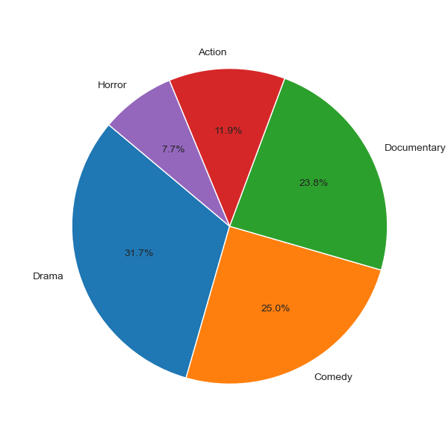
Genre Analysis
Genre distribution
Drama
1st
Is the most prevalent genre in the dataset, accounting for approximately 32.5% of all movies. This is because they often explore complex human emotions and relationships
Comedy
2nd
Comes in as the second most common genre, making up about 25.7% of the dataset. Comedies are known for their lighthearted and humorous themes
Documentary
3rd
These films comprise around 24.5% of the dataset. The relatively high percentage suggests a strong presence of factual and educational content in the dataset.

Slide 7
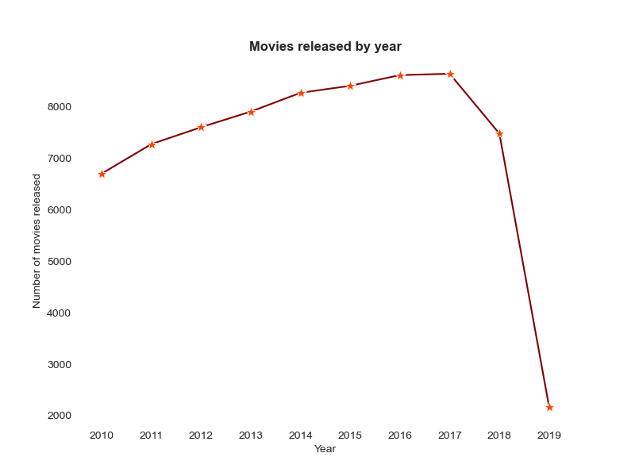
YearLY TRENDS
There was a remarkable increase in the number of movies produced between 2015 and 2017. In 2017, there were 8,638 movies, closely followed by 8,613 in 2016, which makes this two-year period the peak of film production
There was a significant drop in film production in 2019, with only 2,169 movies released. There was as a result of the COVID-19 pandemic.

Slide 8
AVERAGE MOVIE BUDGET
$20M
$15m
$3M
$35m
Cast and Talent Fees
Production Costs
Post-Production Costs
Marketing and Distribution Costs
The salaries and fees paid to actors, directors, producers, writers, and other key members of the creative team
Encompasses Location expenses, crew salaries, equipment rentals, travel and accommodation
Post-production includes the costs of editing, special effects, sound design, and music composition.
Marketing and distribution expenses are critical to promoting and releasing the film to a wide audience.

Slide 9
Global Market Analysis overview
(as of 2022)
$77B
$5.99B
26.5%
The average annual revenue of the global film industry.​
The domestic box office generated revenue
The market share of the European film industry around the globe.

Slide 10
COLLABORATION
Top 10 Studios by releases
"IFC" is the top studio with 166 movie releases, followed by "Uni." (Universal Pictures) with 147, and "WB" (Warner Bros.) with 140 releases. Factors that have contributed to the success of these studios include their production strategies, distribution networks, and the popularity of their films.

Slide 11

Actionable Insights
Genres​
BUDGETING​
Action and adventure genres have been consistent performers at the box office.
Efficient budgeting is crucial for profitability.
Audience​
COLLABORATION​
Targeting young adults has shown significant box office potential.
Strategic collaboration as a key to creative and strategic success.
FRANCHISE AND SEQUEL​
EMERGING TRENDS​
Exploring franchise opportunities can build a loyal fan base.
Adapting to emerging trends is essential for long-term success.

Slide 12

conclusion
In summary, our data-driven analysis has illuminated a clear path for Microsoft's entry into the film industry.
The film industry offers substantial potential, and our insights will guide strategic decisions.
Remaining adaptable to changing trends and tastes is vital for long-term success.
We're excited to embark on this cinematic journey with Microsoft and create content that resonates globally.
Thank you for your support and enthusiasm as we venture into the world of filmmaking."

Slide 13


